Slide 1
Capstone Engagement
Assessment, Analysis, and Hardening of a Vulnerable System
Mary Yang, Cameo Reindl, Christina LeBaron, Rob Myers,
Phillip Snell, Georges Avenie

Slide 2
Table of Contents
This document contains the following sections:
01
Network Topology
02
Red Team: Security Assessment
03
Blue Team: Log Analysis and Attack Characterization
Hardening: Proposed Alarms and Mitigation Strategies
04

Slide 3
Network Topology
‹#›

Slide 4
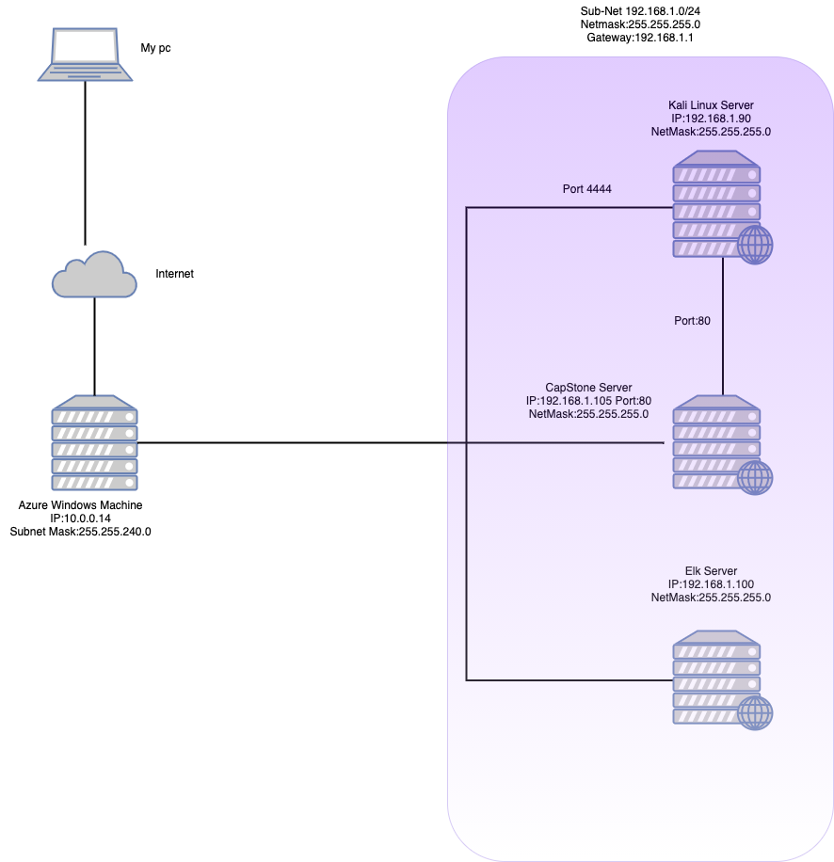
Network Topology
[Network Map]
Use draw.io to create a diagram of the network.
Add your diagram to this slide and fill out the data in the sidebar.
Network:
Address Range:
192.168.1.0/24
Netmask:
255.255.255.0
Gateway:
192.168.1.1
Machines
IPv4:192.168.1.90
OS:Linux
Hostname: Kali
IPv4:192.168.1.105
OS:Linux
Hostname:Capstone
IPv4:192.168.1.100
OS:Linux
Hostname:ELK
IPv4:192.168.1.1
OS:Windows
Hostname:ML-REFVM-684424 AZURE
:

Slide 5

Red Team
Security Assessment
‹#›

Slide 6
Recon: Describing the Target
Nmap identified the following hosts on the network:
Hostname | IP Address | Role on Network
Hyper V (Manager) | 192.168.1.1 | Host of virtual machines used to attack, defend, and monitor activity.
Kali | 192.168.1.90 | Attacker Machine (Kali Linux)
Capstone | 192.168.1.105 | Victim Machine
ELK | 192.168.1.100 | Collect logs from server and application, to analyze

Slide 7
Vulnerability Assessment
The assessment uncovered the following critical vulnerabilities in the target:
Vulnerability | Description | Impact
Port 80 opened | Open ports are dangerous and has poor network security rules. This vulnerability makes sensitive data more publicly accessible | We (attackers) were able to access sensitive files.
Local File inclusion Vulnerability | LFI allows access into confidential files on a site. This is a web vulnerability on the programming side that a hacker can exploit to add malicious executable files. | We exploited this web vulnerability by adding a reverse shell script file to the website that when clicked, allowed us access to the victim’s machine.

Slide 8
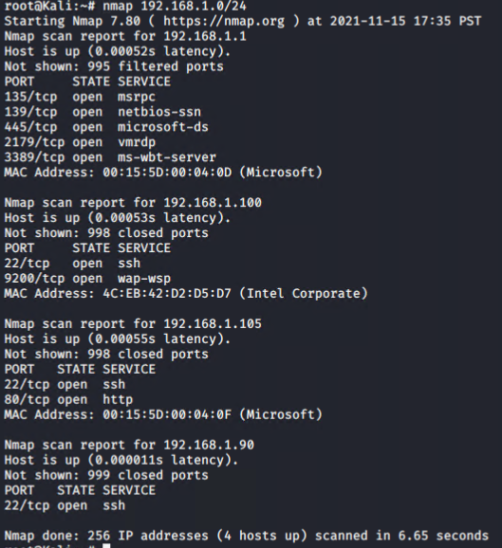
Exploitation: [Nmap scan]
01
02
Tools & Processes
How did you exploit the vulnerability? Which tool (Nmap, etc.) or techniques (XSS, etc.) did you use?
To find this vulnerability we used nmap to discover which ports are open and which services are being used.
Achievements
What did the exploit achieve? For example: Did it grant you a user shell, root access, etc.?
We discovered that our target machine with IP 192.168.1.105 had port 80 open. Through this port we were able to access the website’s directory and find sensitive file data.

Slide 9
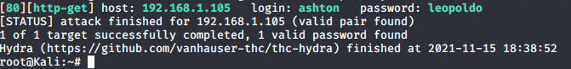
Exploitation: [Brute Force:]
01
02
Tools & Processes
Hyrdra- used against directory to find secret folder and brute force into Capstone (victim’s) machine
Achievements:
User: Ashton
Pw: leopoldo
With this information we were able to access system

Slide 10
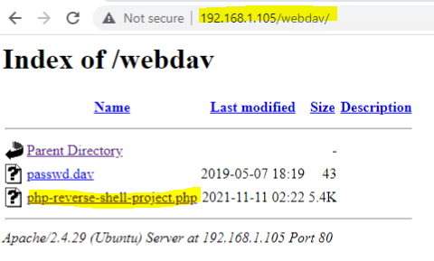
Exploitation: [Php Script]
01
02
03
Tools & Processes
Using open port 80, we accessed the target IP address in a web browser to view the vulnerable directories.
Achievements
This allowed us to find confidential login information and identify where important files were located.
Because the website has an LFI vulnerability, we are able to write a malicious executable file into the website’s directory.

Slide 11

Blue Team
Log Analysis and Attack Characterization
‹#›

Slide 12
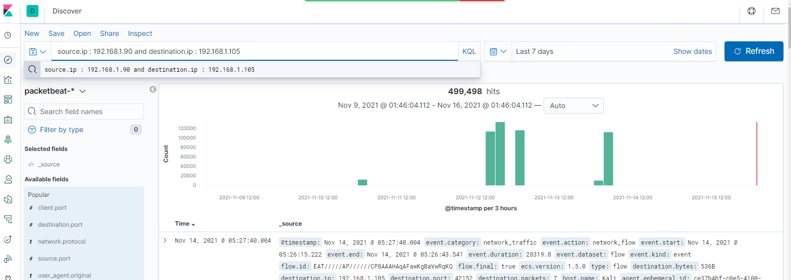
Analysis: Identifying the Port Scan
What time did the port scan occur? Dashboard indicates the time as 6:00pm
How many packets were sent, and from which IP? 499,498 hits from IP: 192.168.1.105
What indicates that this was a port scan? Using scan source.ip : 192.168.1.90 and destination.port : 4444 demonstrates the port scan
[Insert Here]
Include a screenshot of Kibana logs depicting the port scan.

Slide 13
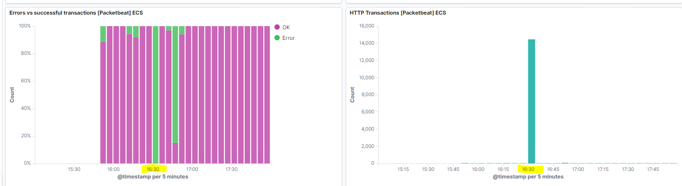
Analysis: Finding the Request for the Hidden Directory
What time did the request occur?4:30pm
How many requests were made? 14423
Which files were requested? http://192.168.1.105/company_folders/secret_folder
What did they contain? The Secret Folder contained the HASH for Ryans Password
[Insert Here]
Include a screenshot of Kibana logs depicting the request for the hidden directory.

Slide 14
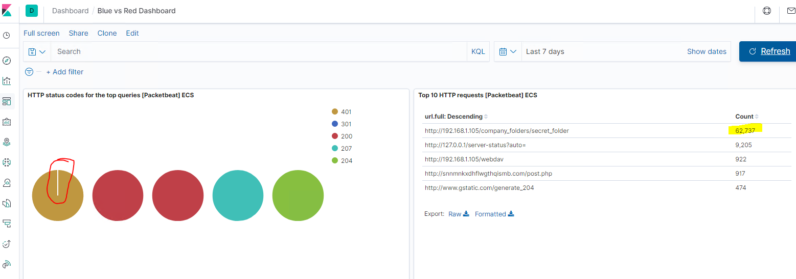
Analysis: Uncovering the Brute Force Attack
How many requests were made in the attack? 14423
How many requests had been made before the attacker discovered the password? 62737 total requests and only 1 user got through
Sorry this is all wrong
Include a screenshot of Kibana logs depicting the brute force attack.

Slide 15
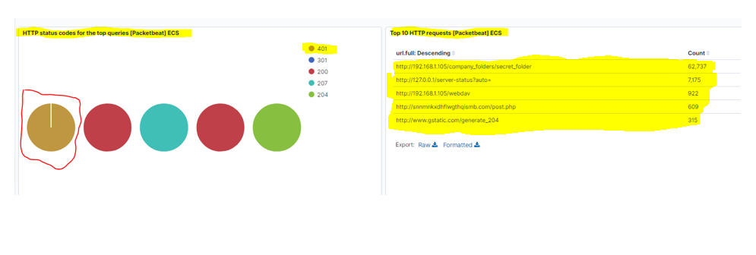
Analysis: Finding the WebDAV Connection
How many requests were made to this directory? http://192.198.1.105/webdav count was 922
Which files were requested? post.php
[Insert Here]
Add a screenshot of Kibana logs depicting the WebDAV connection.

Slide 16
Blue Team
Proposed Alarms and Mitigation Strategies
‹#›

Slide 17
Mitigation: Blocking the Port Scan
What kind of alarm can be set to detect future port scans?
Establish an Alarm anytime there are more than 16,000 400 Error Requests in FIVE minutes
What configurations can be set on the host to mitigate port scans?
Enable only the traffic needed to access internal hosts and deny everything else.
Configure Fire Wall Rules to cut off attacks if a certain threshold is reached, such as 10 port scans in one minute.
Describe the solution. If possible, provide required command lines.
Use your IDS like Kibana or SPLUNK for immediate alerting inorder to initiate the rapid response team

Slide 18
Mitigation: Finding the Request for the Hidden Directory
What kind of alarm can be set to detect future unauthorized access?
Implement a strong password policy that locks out a user for 15 minutes after three unsuccessful login’s as well as completely locking out the user after six unsuccessful login’s
Recomend implementing a multi-authentication procedure when resetting passwords
What configuration can be set on the host to block unwanted access?
Create a rule that locks out a user after a password threshold has been met
Describe the solution. If possible, provide required command lines.
When a user enters three wrong passwords the user is locked out for 15 minutes

Slide 19
Mitigation: Preventing Brute Force Attacks
What kind of alarm can be set to detect future brute force attacks?
Establish an Alarm when the user-agent.original indicates: Mozilla/4.0 (Hydra)
Set the threshold to: ZERO
What configuration can be set on the host to block brute force attacks?
Set rule to state: Block user-agent.original indicates: Mozilla/4.0 (Hydra)
Describe the solution. If possible, provide the required command line(s).
When the Hydra user agent is detected block that traffic

Slide 20
Mitigation: Detecting the WebDAV Connection
What kind of alarm can be set to detect future access to this directory?
Create Alert anytime the IDS detects any webdav, PHP, or remote access connection
What threshold would you set to activate this alarm?
Threshold is Zero
What configuration can be set on the host to control access?
Establish a rule that blocks: webdav, PHP, or remote access connection
Describe the solution. If possible, provide the required command line(s).
Any remote access connection is unauthorized and requires immediate response

Slide 21
Mitigation: Identifying Reverse Shell Uploads
What kind of alarm can be set to detect future file uploads?
Establish alarm anytime a file is uploaded from outside the internal network
What threshold would you set to activate this alarm?
Threshold is Zero
What configuration can be set on the host to block file uploads?
Establish a rule that blocks all file uploads from outside the internal network.
Establish rules that restrict users from uploading files with out permission

